Slide 1

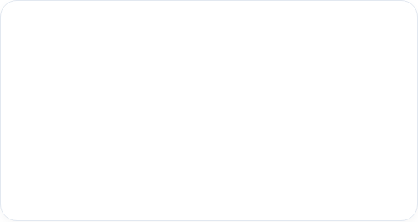

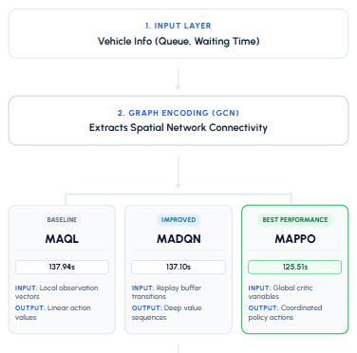
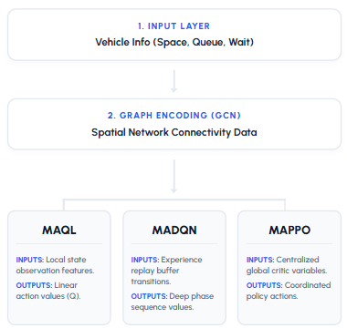














Intelligent Multi-Agent Reinforcement Learning Framework
for Adaptive Traffic Signal Control
About Project
MARL Coordination
Spatial Awareness
Addresses the "Single-Agent Gap" using cooperative MAPPO, MAQL and MADQN Algorithms.
Integrates GCN embeddings for intelligent network-wide intersection coordination.
Efficiency Gains
Traffic Densities
Achieves 8.6% faster travel times in high-density Manhattan grid scenarios.
Train model for various traffic densities like low, medium and high.
9. Industry, Innovation & Infrastructure
Tools & Technologies used
Python
PyTorch
SUMO
GCN
colab
+
Enhanced Scalability
+
Travel Time Efficiency
Group Members:
Amna Tanveer
Maham Shahid
Supervisor::
Dr. Hasan Humayun
+
improved Adaptability
+
Enhanced Coordination
Department of Software Engineering,
Faculty of Engineering and Computing, NUML
Optimized SignalAction Recommendation
GROUP MEMBERS
SUPERVISOR
MARL Research Team
Faculty of Engineering & IT

